Slide 1

GYM SUBSCRIPTION MANAGEMENT SYSTEM
FITHUB
KIIT University

Slide 2





FITHUB
Fithub is an innovative online gym subscription management system designed to streamline the operations of traditional fitness centers.
The platform provides a simple interface for easy sign-up, offering various subscription plans and seamless appointment booking.

Slide 3

PROBLEM STATEMENT
Despite the growing demand for fitness services, traditional gym management systems often struggle to keep pace with evolving consumer expectations and operational challenges.
Traditional gyms often handle membership registration, subscription management, and payment processing manually, leading to errors and inefficiencies.

Slide 4
PROJECT GOALS
01
Develop a user-friendly online platform with intuitive navigation and seamless functionality for gym members and administrators, streamlining subscription management and appointment scheduling.
02
Automate membership processes and centralize data management to enhance operational efficiency, improve data accuracy, and facilitate informed decision-making by administrators, ultimately optimizing gym performance.

Slide 5

PROCESS
Designing: Utilizing Figma to create the user interface design, ensuring a visually appealing and intuitive layout for the mobile app.
Coding: Progressing to the coding phase, implementing functionalities and features in CSS, HTML, and JavaScript based on the designed UI specifications.
Testing and Deployment: Conducting thorough testing and seamlessly deploying the website to ensure optimal performance,

Slide 6
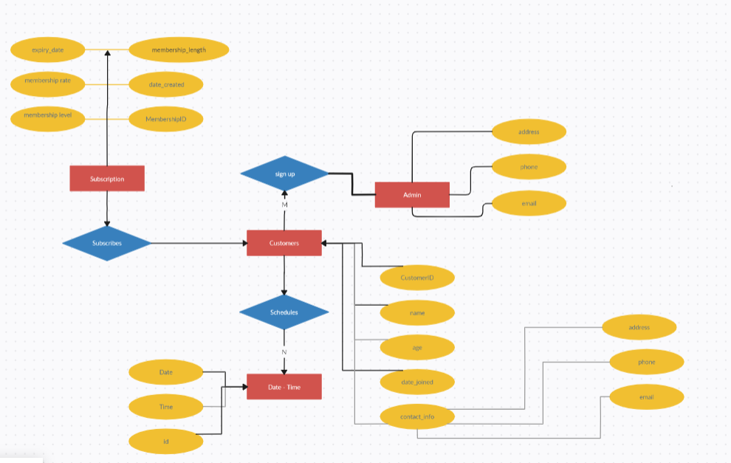
STRUCTURE
ER DIAGRAM

Slide 7
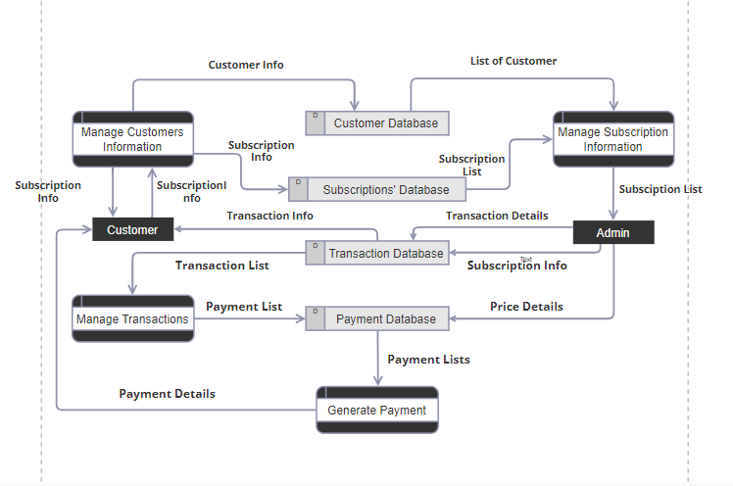
STRUCTURE
DFD DIAGRAM

Slide 8
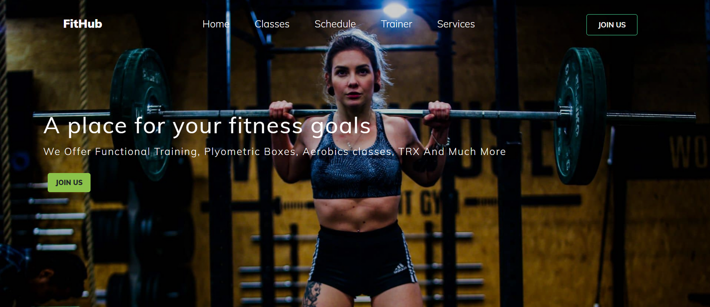
RESULT
LANDING PAGE

Slide 9
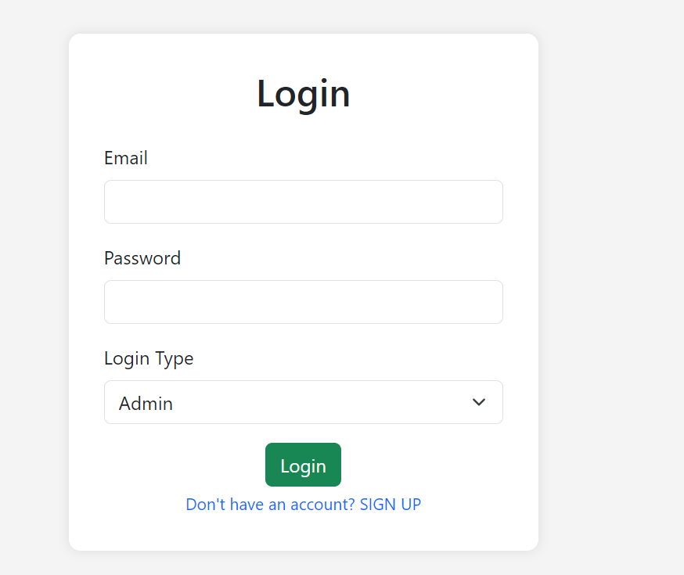
RESULT
lOGIN PAGE

Slide 10
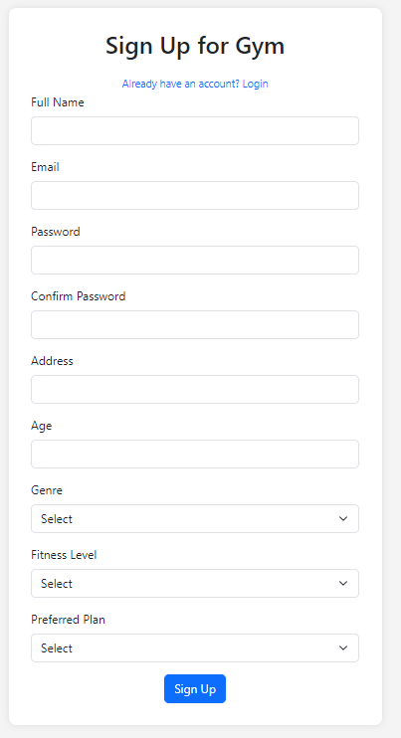
RESULT
SIGN UP PAGE

Slide 11
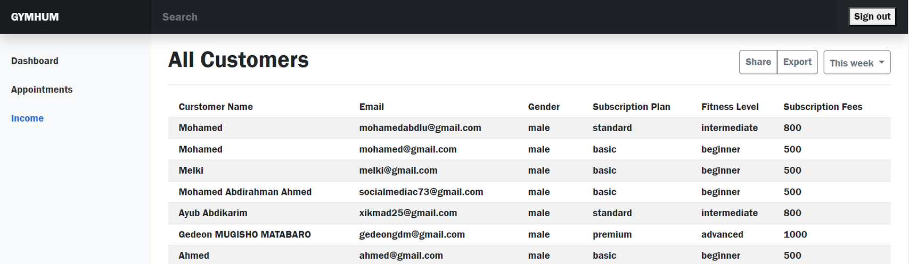
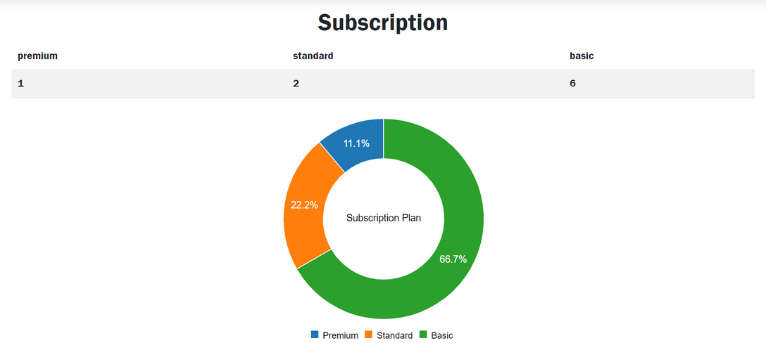
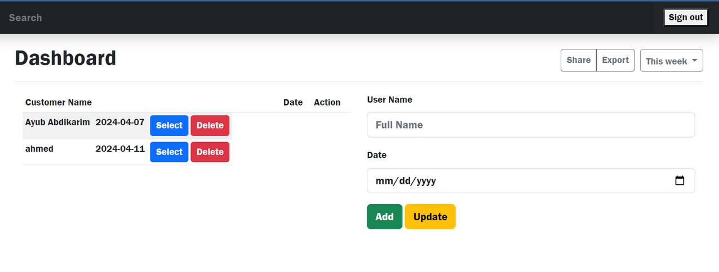
RESULT
ADMIN PAGES

Slide 12
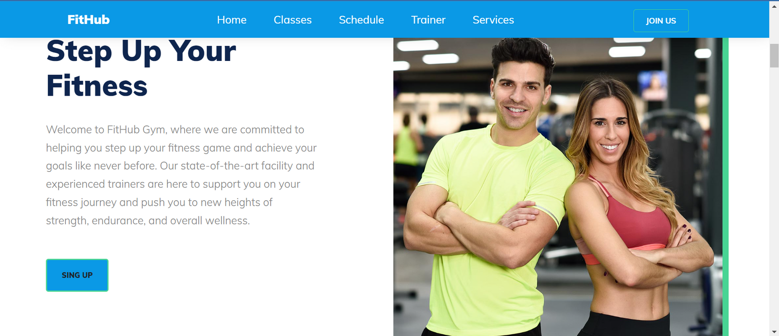
RESULT
OTHER PAGES

Slide 13
THANK YOU
For your attention

